Slide 1
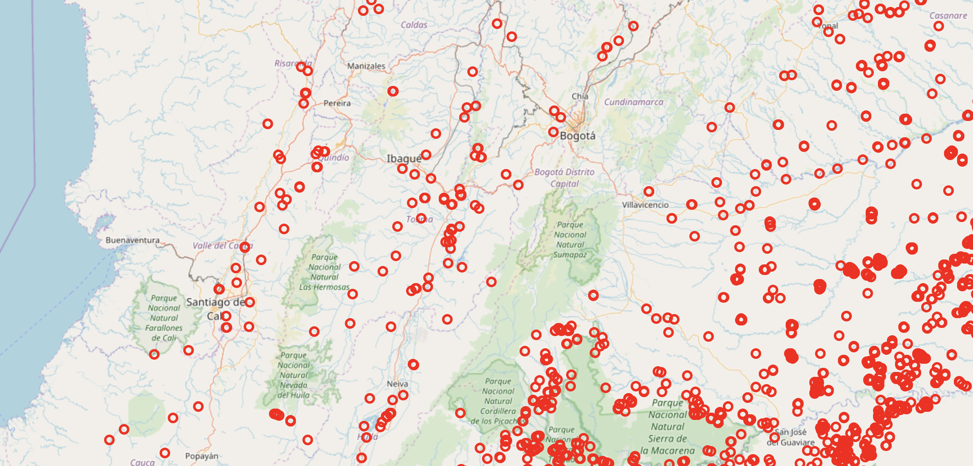
Tracking fires worldwide
March 9th
Juliana Aguilar
Lucía Delgado
Jorge Quintero

Slide 2
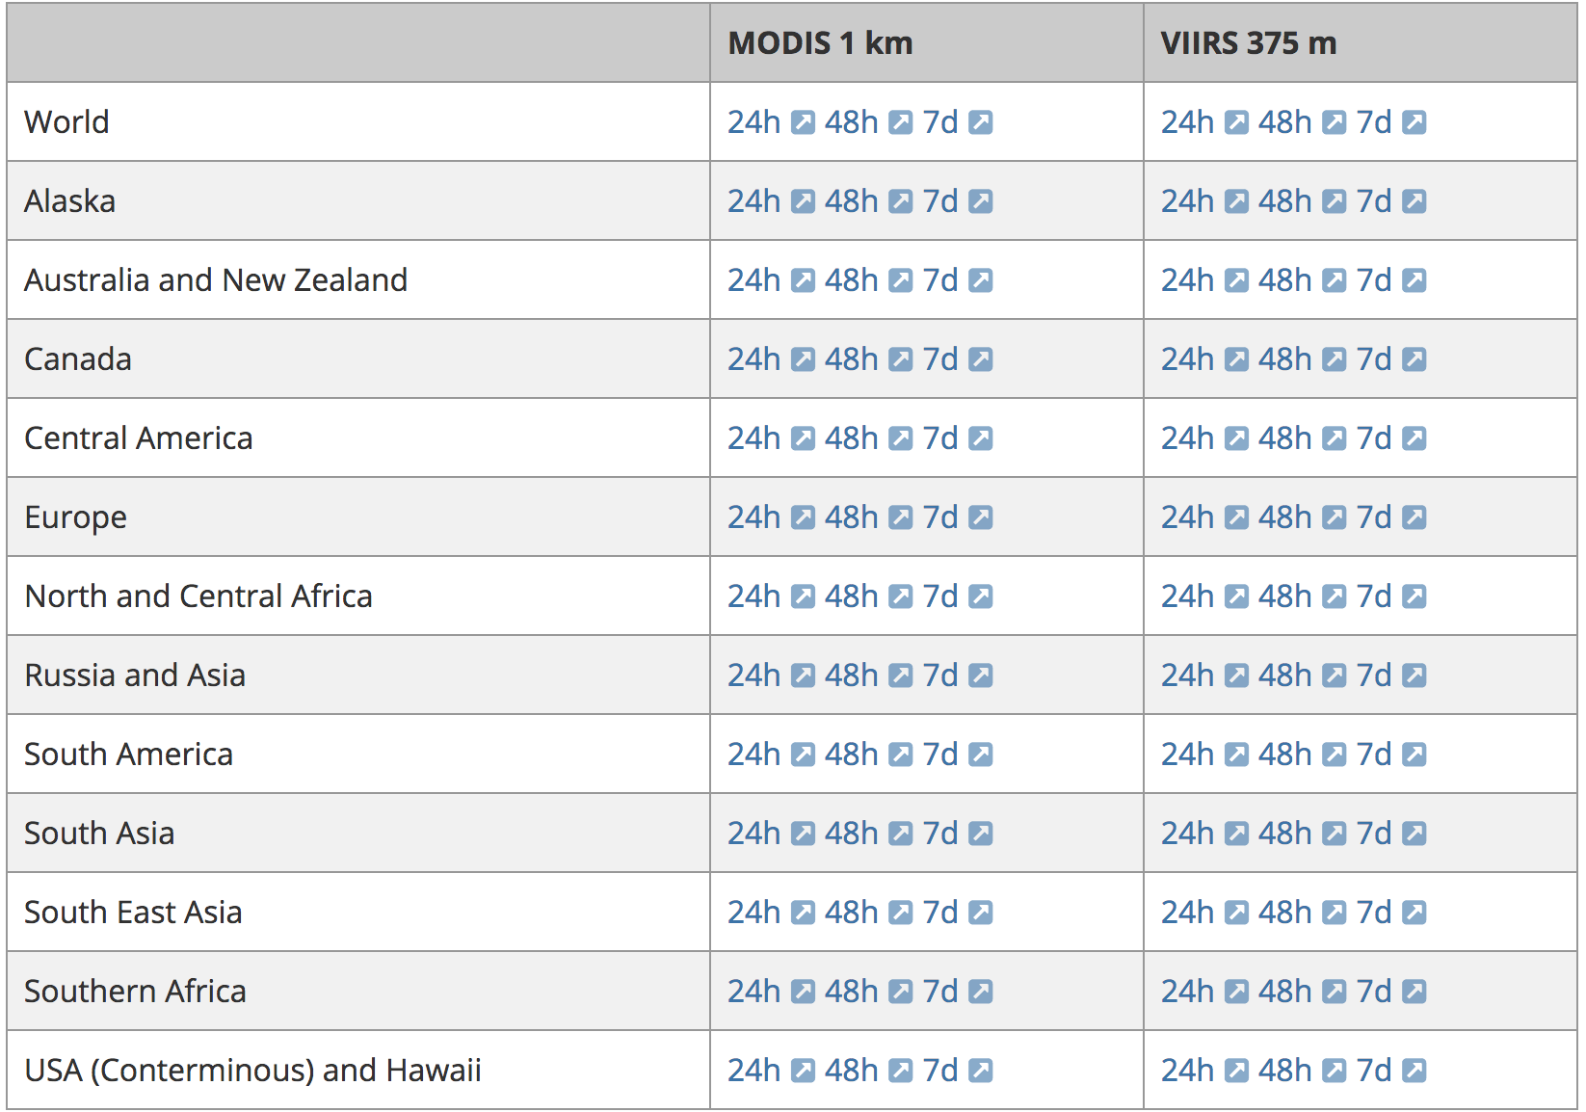
Fires data (data_downloader.py)
Table from NASA website
Built a soup
Downloaded and stored daily data
Created a file dictionary to be used later
Source: earthdata.nasa.gov

Slide 3
Global Human Settlements
Cuts raster data for each country
Overlaps with fire data set
Takes mean settlement values in a buffer around each fire

Slide 4
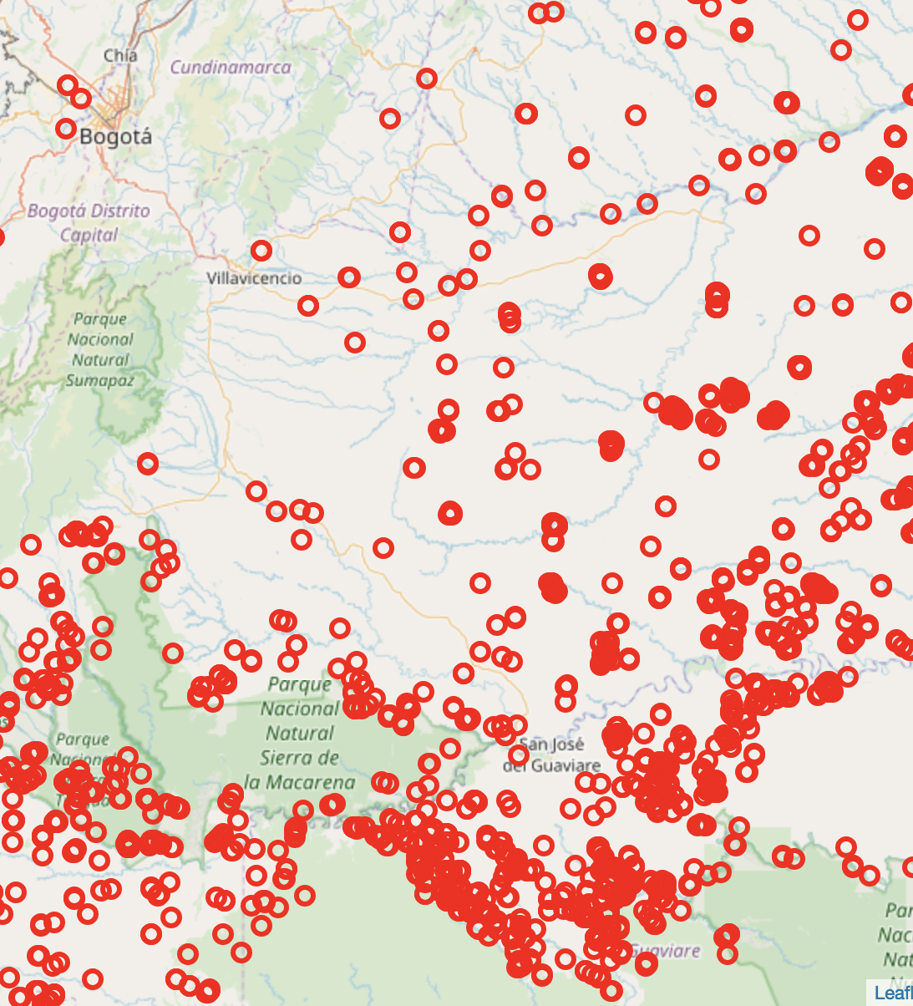
Maps
Example of fire map (Colombia)
Select data for each country
Map data for a given country
Use Django to display maps (in progress)

